Slide 1
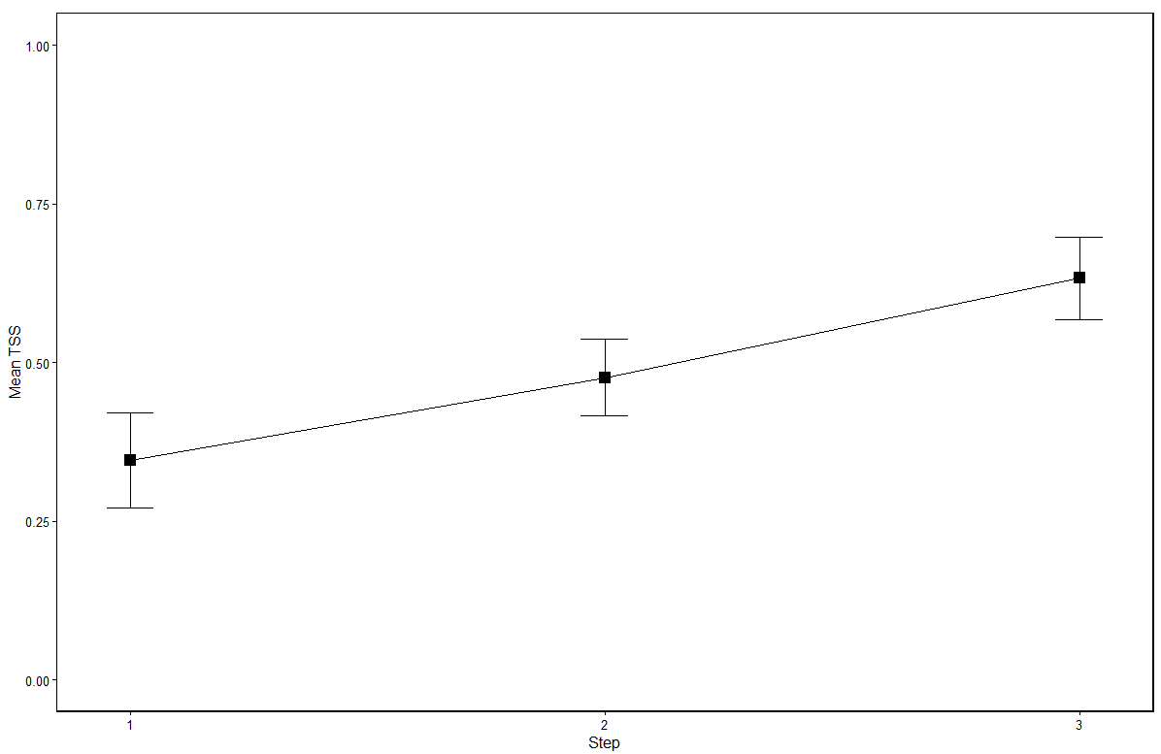
Gravel TSS ~ 3 steps
True Skill Statistic; TSS =
(a*d - b*c)/((a+c)*(b+d))
a = true positive; links both obserevd & predicted
b = false positive; predicted but not observed
c = false negative; observed but not predicted
d = true negative; not predicted, not observed
TSS = 1 = perfect prediction
TSS = -1 = inverse prediction
Step 1 = body mass fxn, step 2 = prune, step 3 = relative abundance

Slide 2
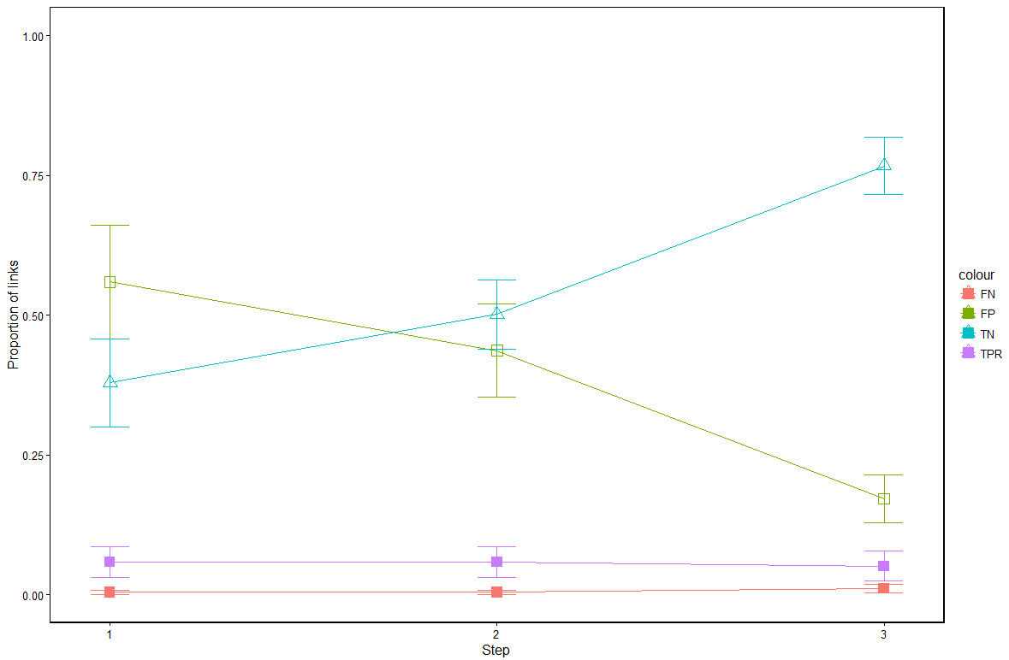
Gravel TSS components ~ 3 steps
FN = false negative
predicted to be absent, but observed
FP = false positive
predicted to be present, not observed
TN = true negative
predicted absence, not observed
TPR = true positive
predicted presence and observed

Slide 3
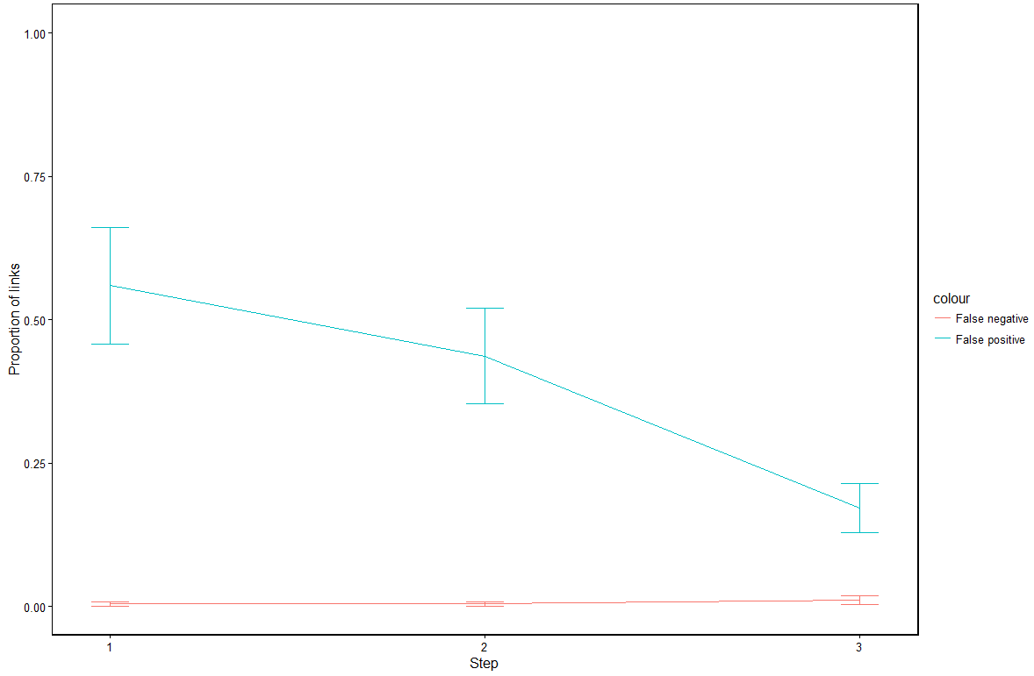
Gravel False Positive False Negative ~ 3 steps

Slide 4
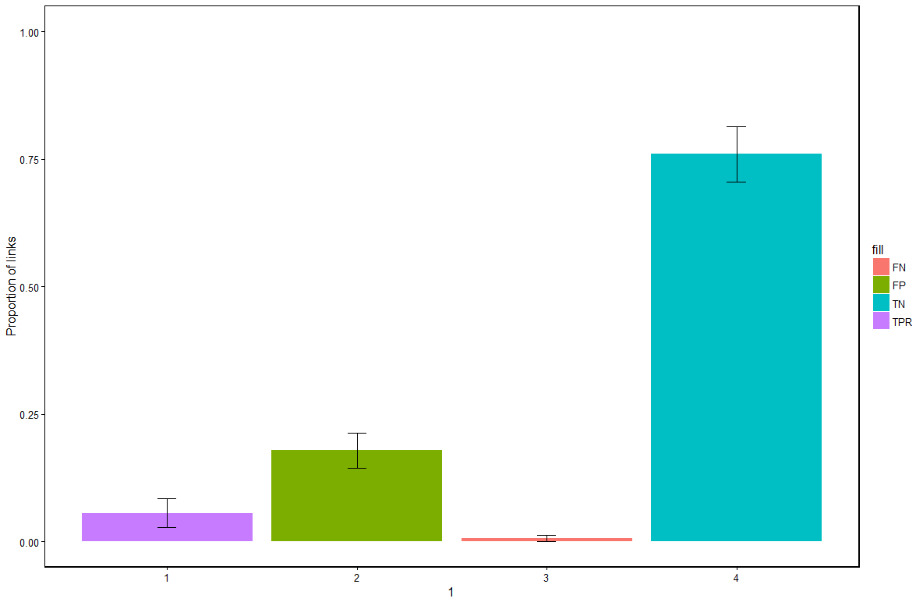
WebBuilder TSS components Proportion of links

Slide 5
Model | True Positive | True negative | False positive | False negative
WebBuilder | 0.0557 | 0.7595 | 0.1784 | 0.0064
Gravel, step 3 | 0.0510 | 0.7668 | 0.1711 | 0.0111
Mean proportion of links for food webs inferred using the WebBuilder function, and the 3rd step in the modified gravel method

Slide 6
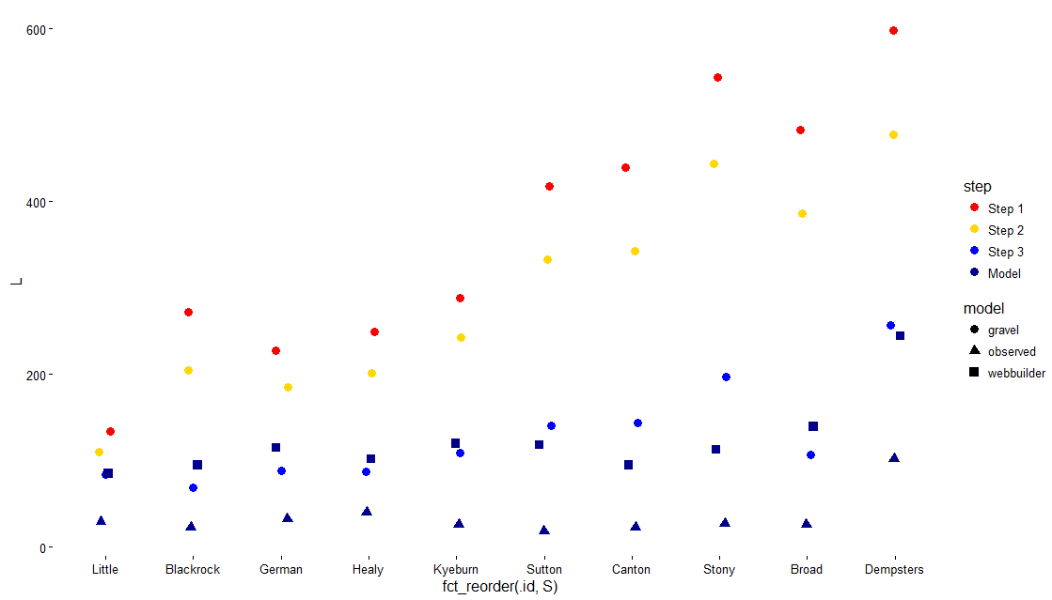
Number of links (L), sites plotted by increasing number of species (S)

Slide 7
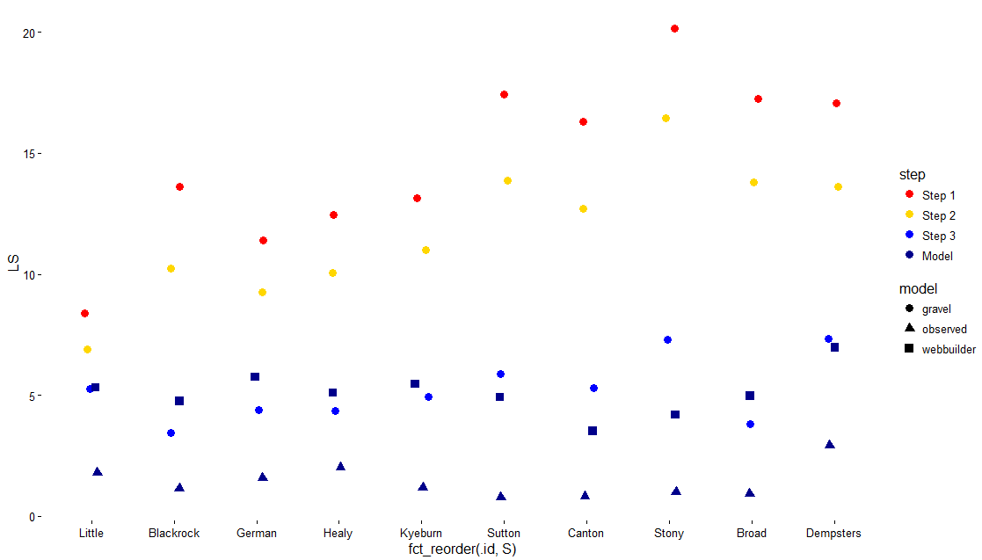
Number of links per species (L/S), sites plotted by increasing number of species (S)

Slide 8
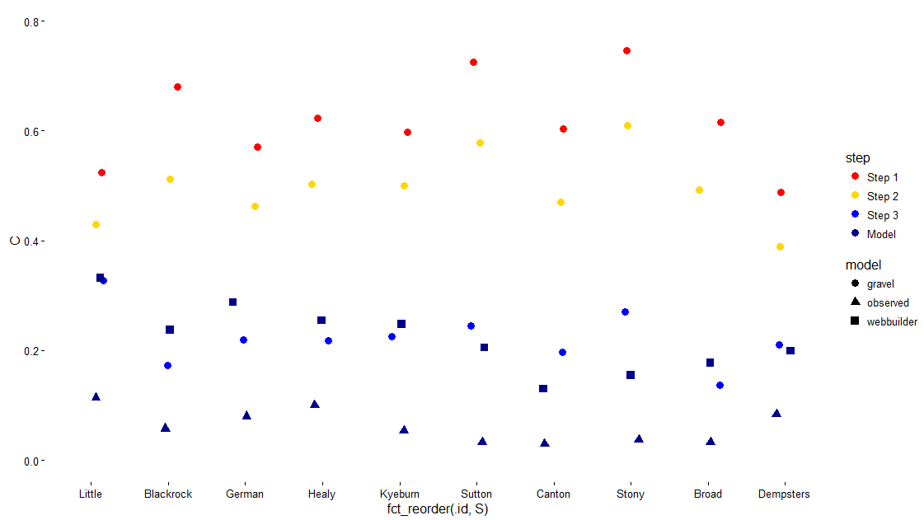
Connectance (C = L / S^2), sites plotted by increasing number of species (S)

Slide 9
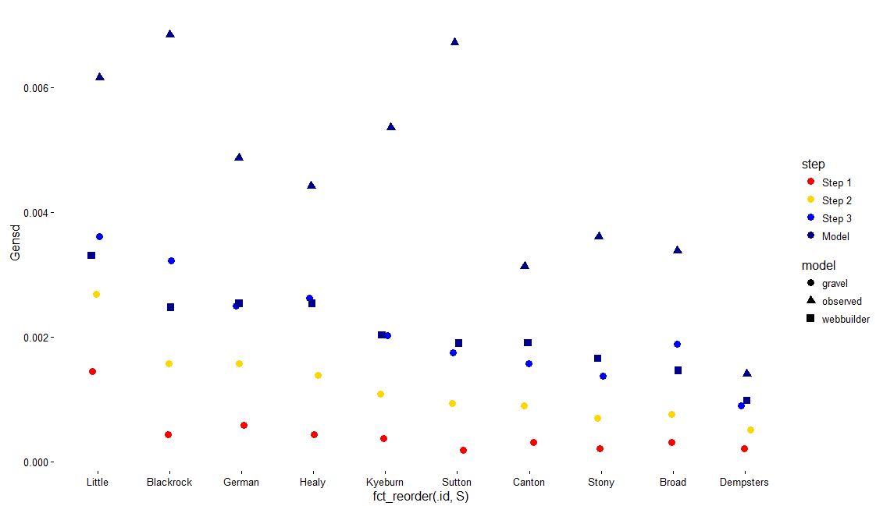
Standard Deviation of Generality, sites plotted by increasing number of species (S)

Slide 10
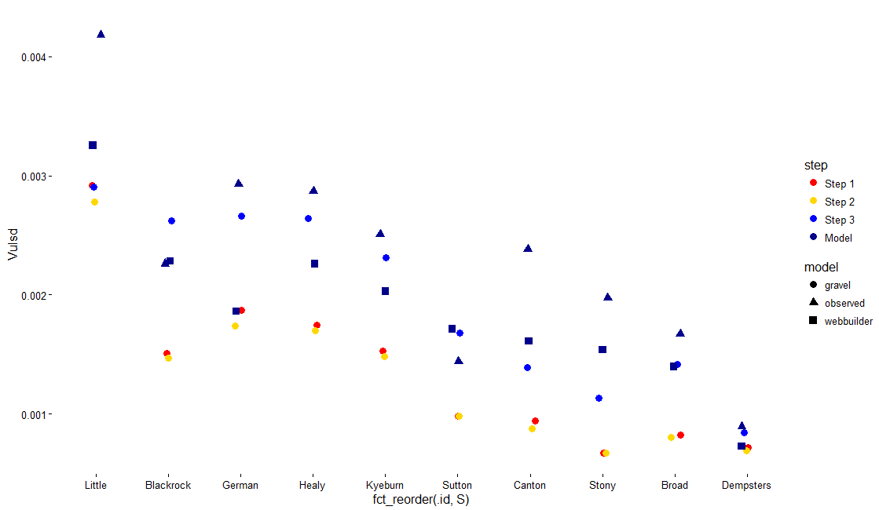
Standard Deviation of Vulnerability, sites plotted by increasing number of species (S)

Slide 11
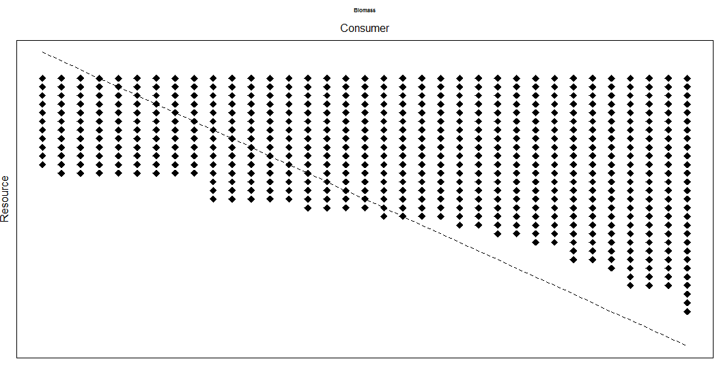
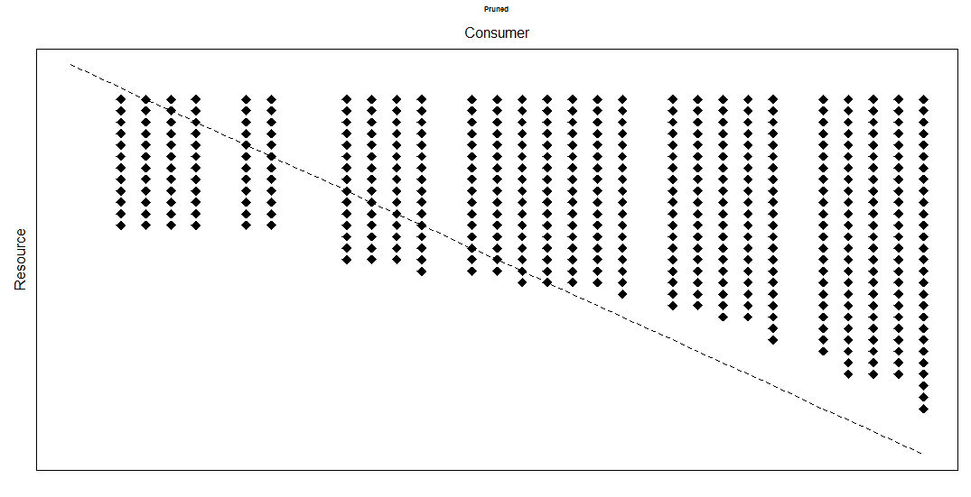
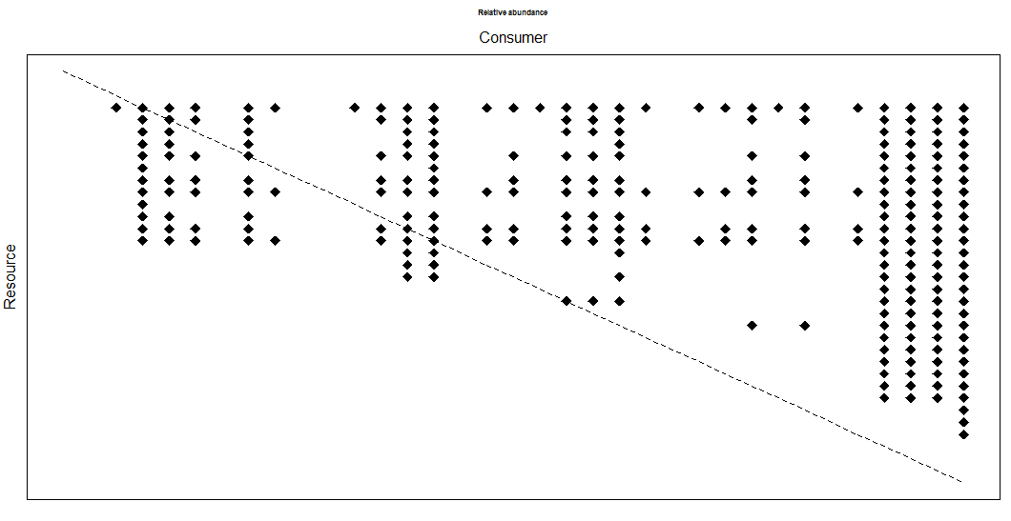
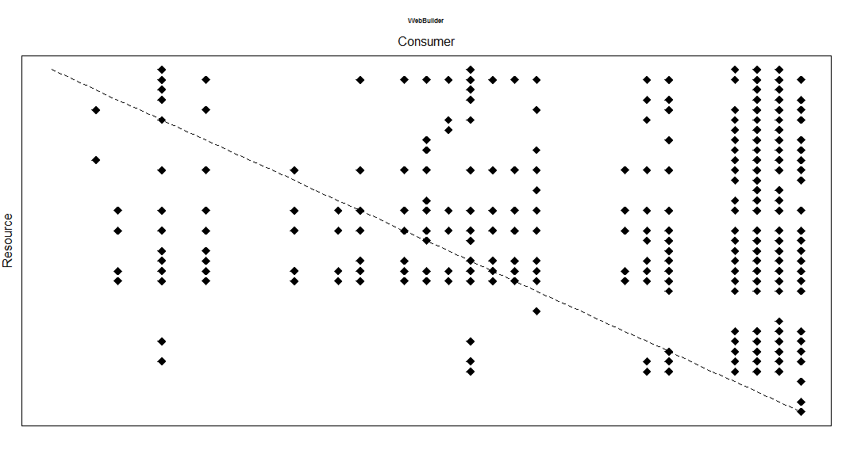
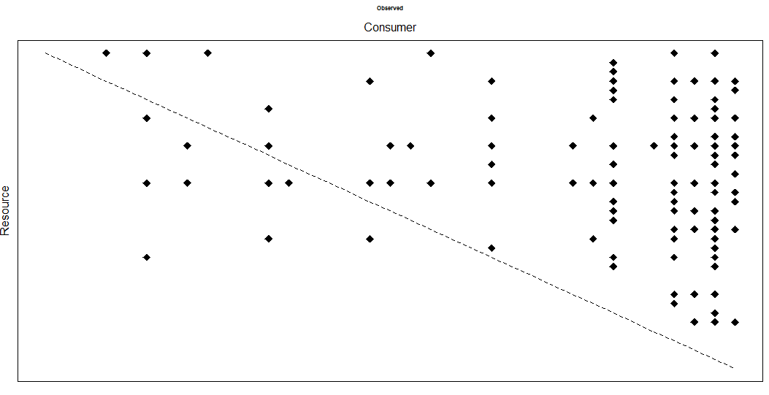
Dempsters Creek
Biomass inferred
Pruned
Relative abundance threshold
Gravel method, 3 steps
WebBuilder
Observed Network

Slide 12
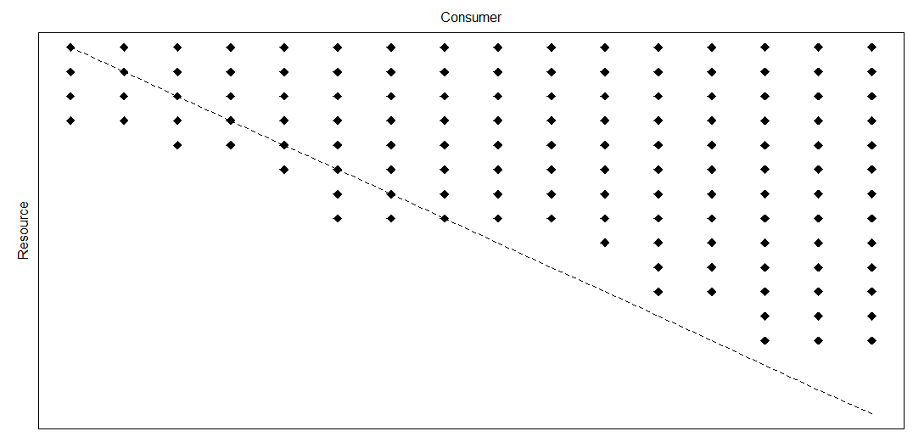
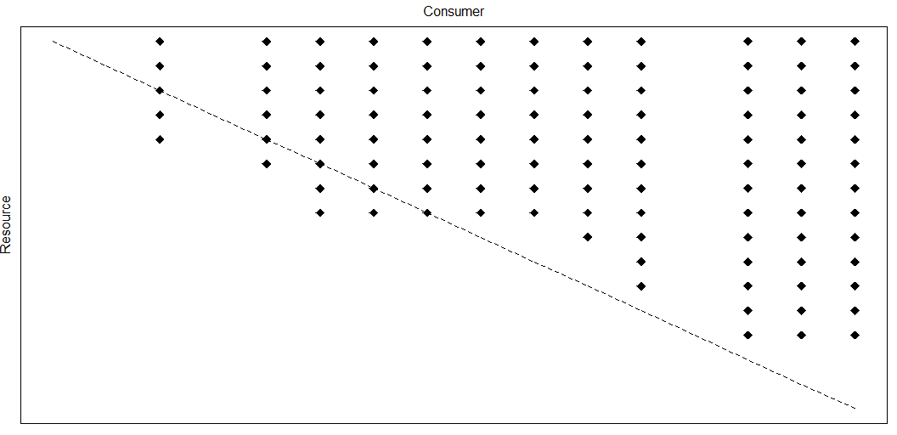
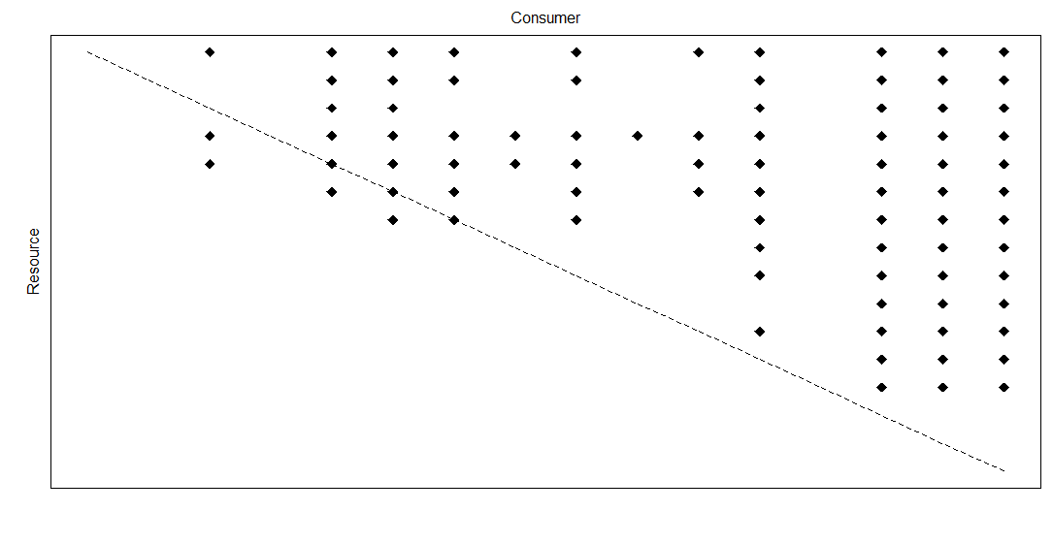
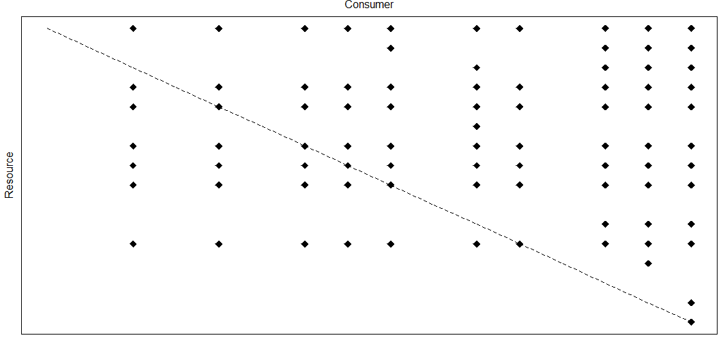
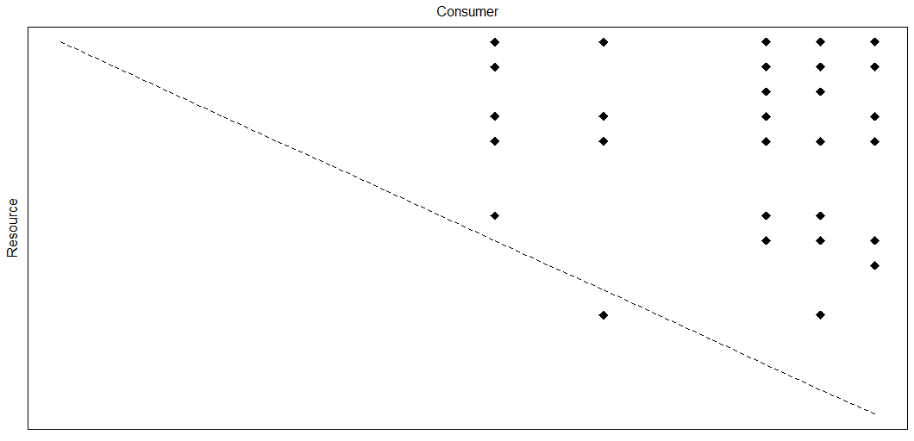
Little Kye Burn Creek
Biomass inferred
Pruned
Relative abundance threshold
Gravel method, 3 steps
WebBuilder
Observed Network

Slide 13
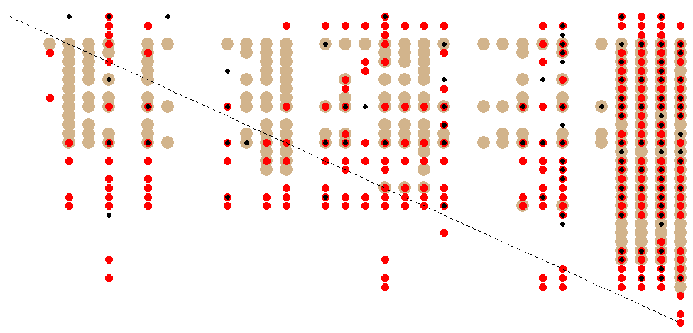
Dempster; Tan = gravel step 3; red = webbuilder, black = observed

Slide 14
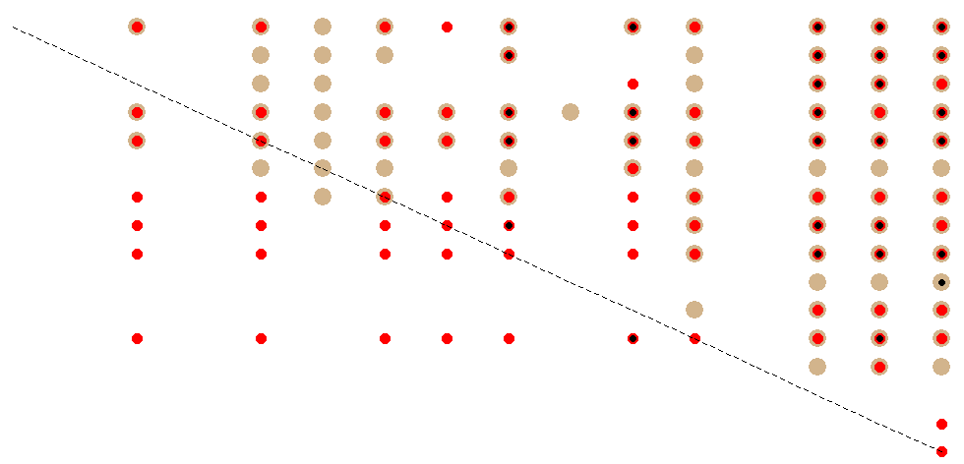
Little Kye Burn; Tan = gravel step 3; red = webbuilder, black = observed

Slide 15
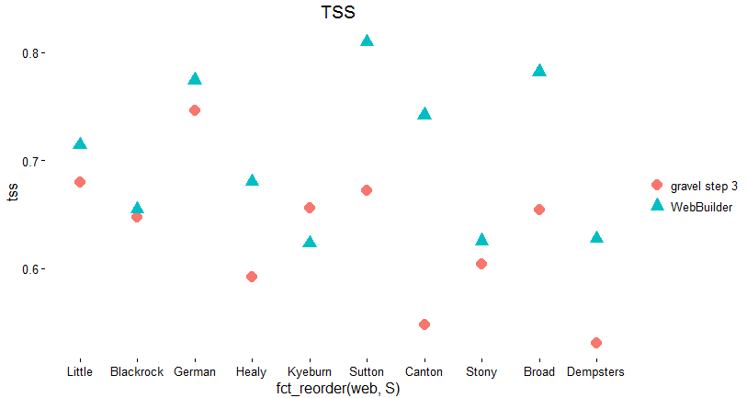

Slide 16
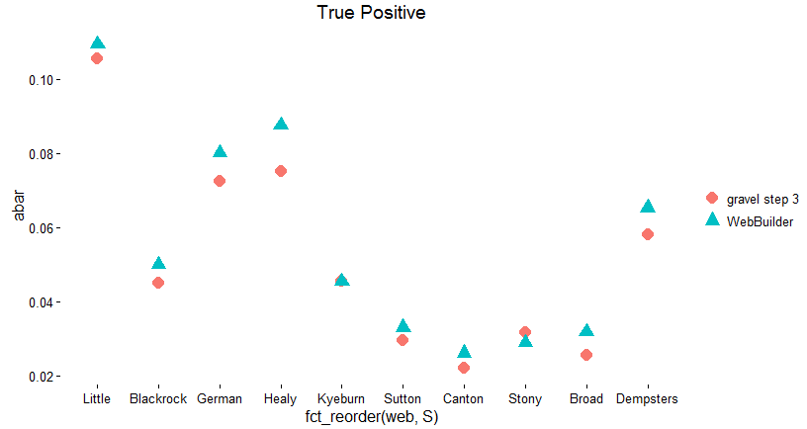

Slide 17
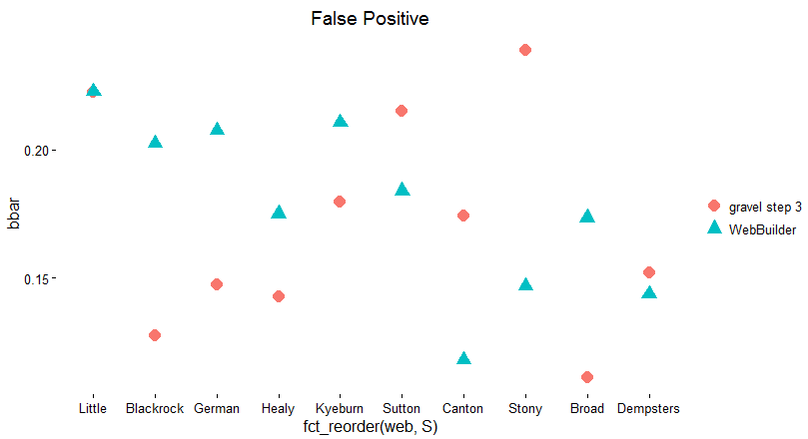

Slide 18
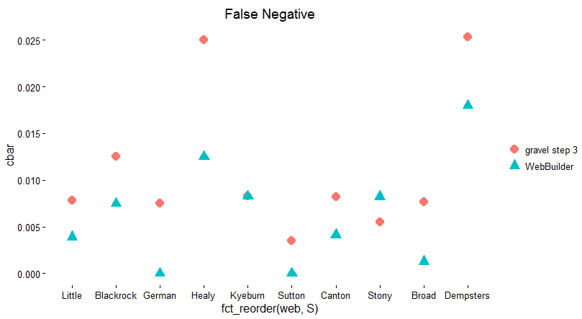

Slide 19
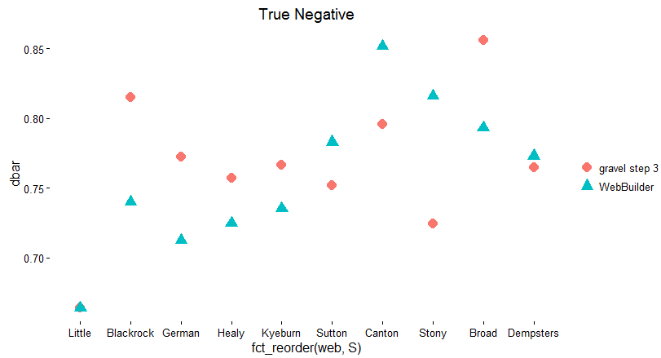

Slide 20
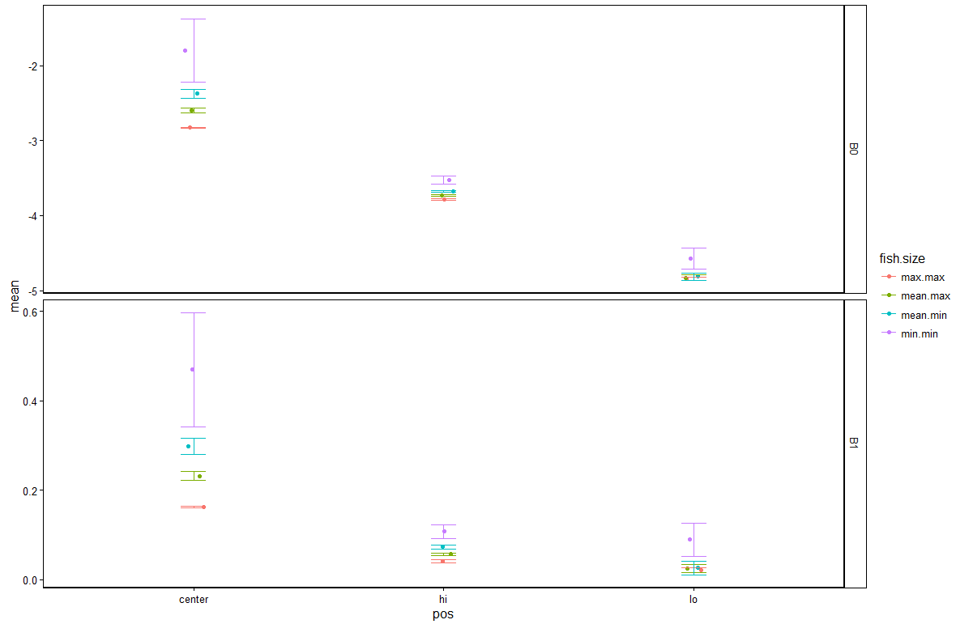
Gravel parameter coefficients ~ 4 fish size
Supplemental. Parameters for gravel model, using 4 different sizes of fish. B0 = intercept of the hi, center, and lo quantile regression. B1 = slope of hi, center and lo quantile regression.
Max.max = maximum max fish length, mean.max = mean maximum fish length, mean.min = mean minimum fish length, min.min = minimum min fish length

Slide 21
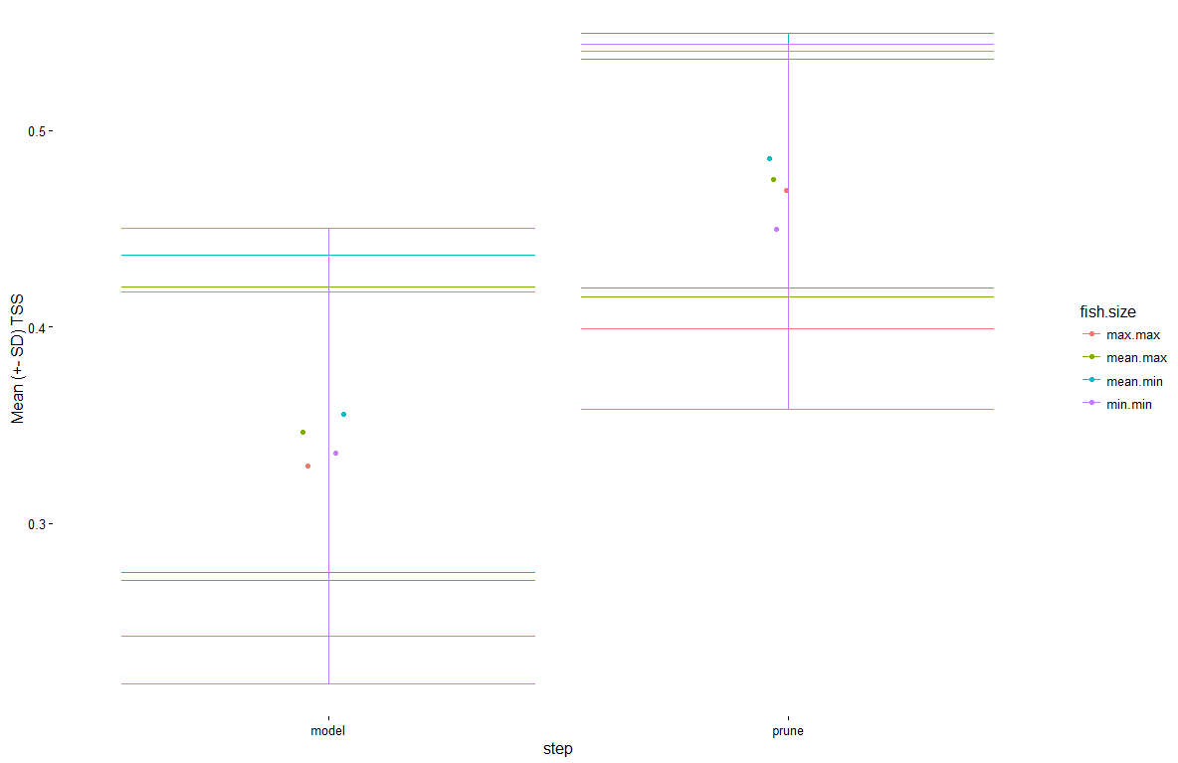
Supplemental. Mean TSS (+- SD), using 4 different sizes of fish. Model = initial inference. Prune = pruning “forbidden links” based on taxonomy.
Max.max = maximum max fish length, mean.max = mean maximum fish length, mean.min = mean minimum fish length, min.min = minimum min fish length
Gravel TSS ~ 4 fish size

Slide 22
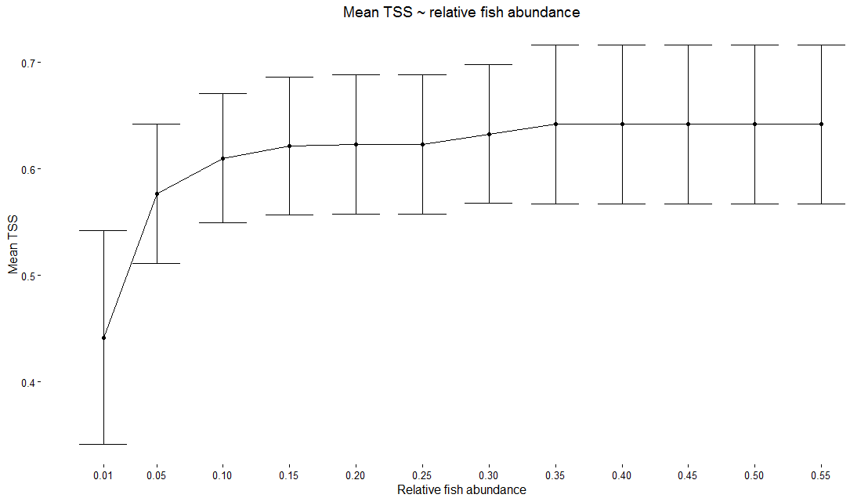
Gravel TSS ~ fish relative abundance values

Slide 23
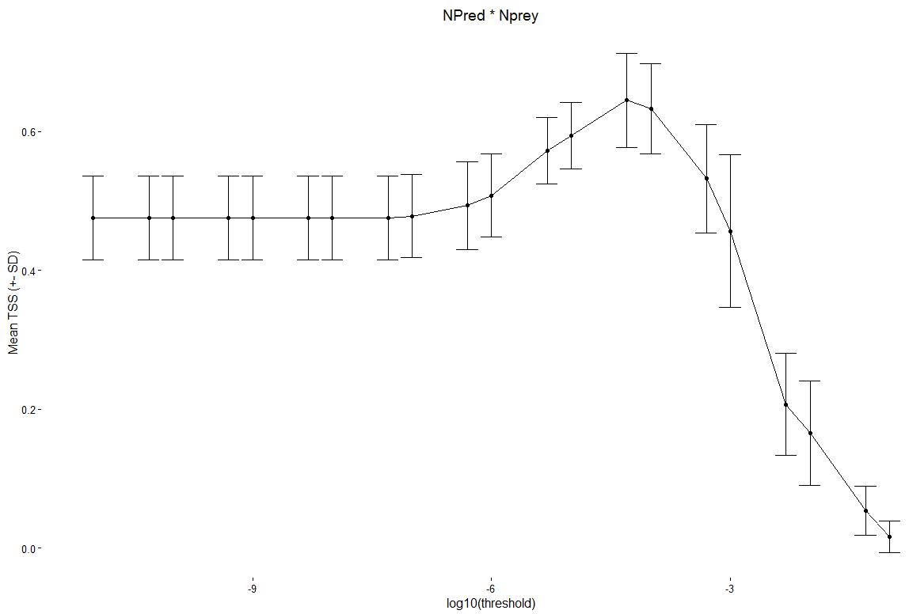
Gravel TSS ~ relative abundance threshold
Supplemental figure (?)
Parameterization of relative abundance correction for Gravel model. Relative abundance calculated by multiplying

Slide 24
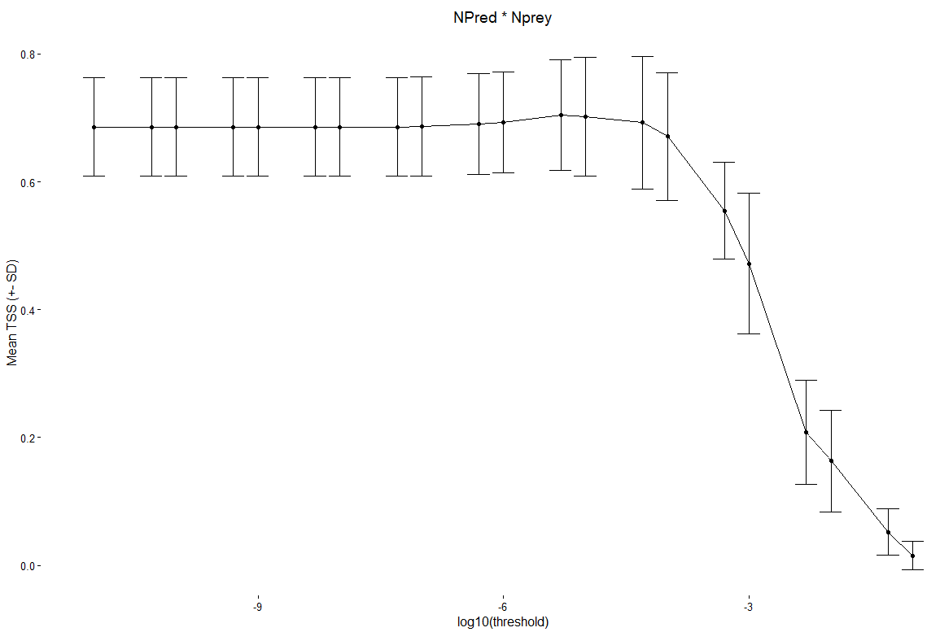
WebBuilder TSS~ relative abundance threshold
Supplemental figure (?)
Parameterization of relative abundance correction for Gravel model. Relative abundance calculated by multiplying relative abundance predator * relative abundance prey

Slide 25
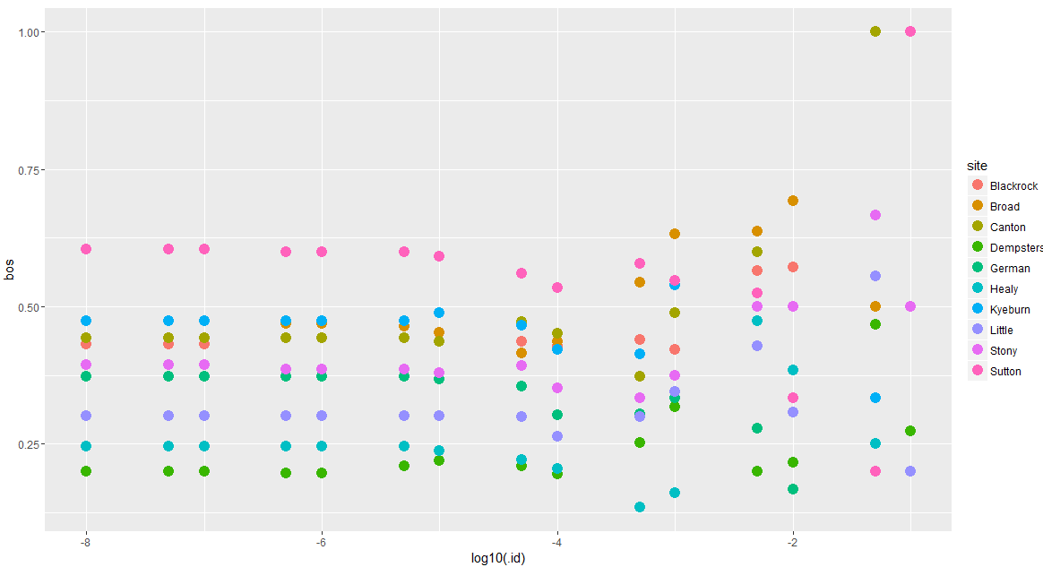
β’_{os} for observed webs removing relatively low abundant species. (Rare species to the left).
bos = dissimilarity between local web and counterpart in metaweb.
bos = 0 when all interactions found in metaweb are also found in realization (perfect similarity).
bos close to 0 = low local selection of interactions
bos close to 1 = strong local selection of interactions

Slide 26
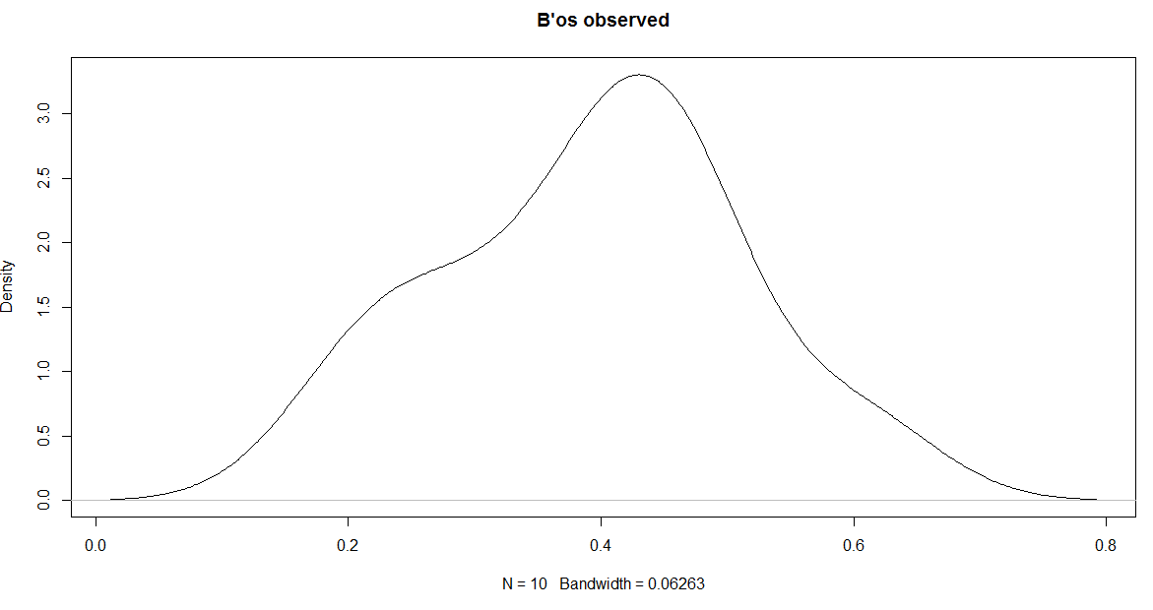

Slide 27
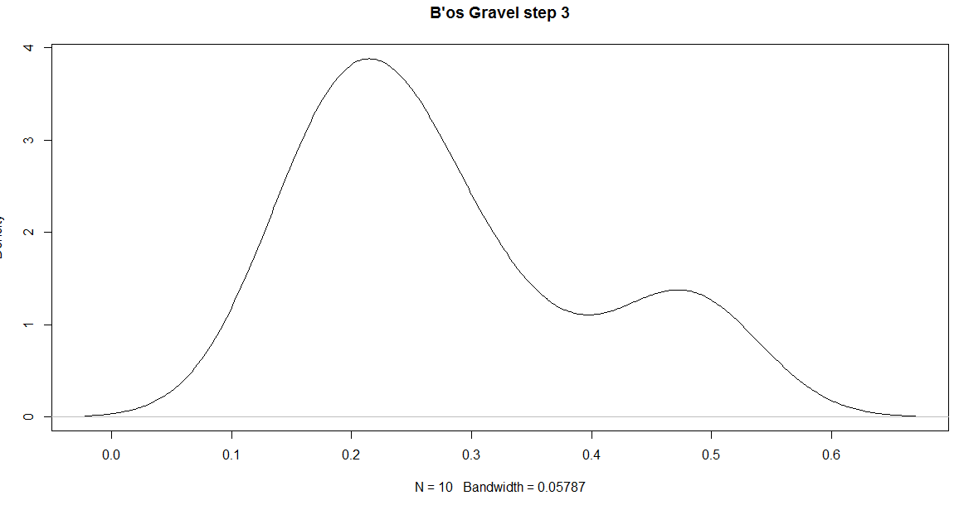

Slide 28
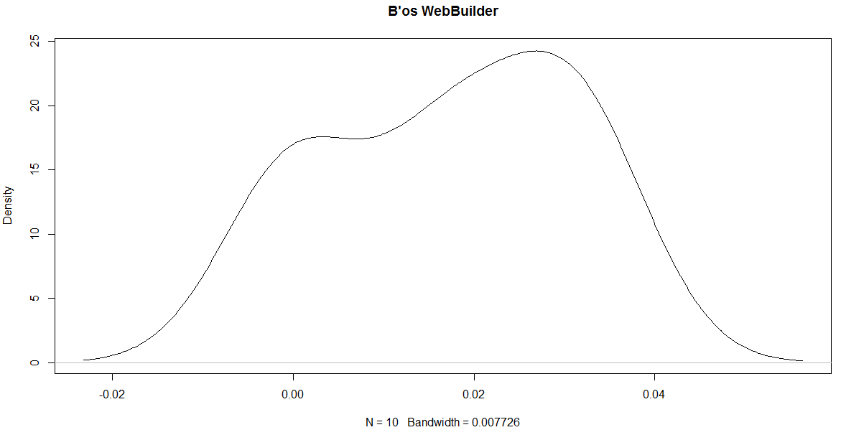

Slide 29
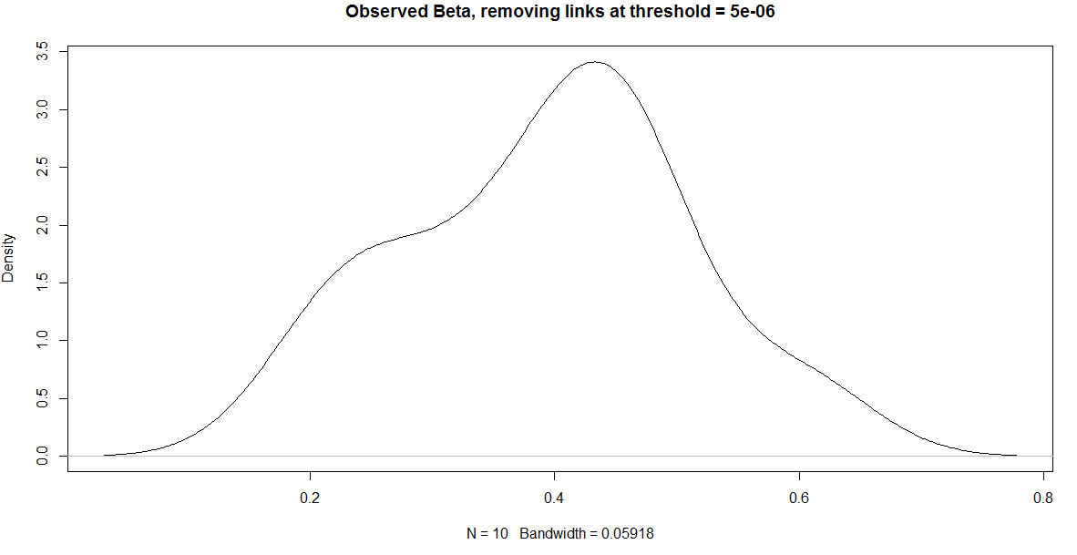

Slide 30
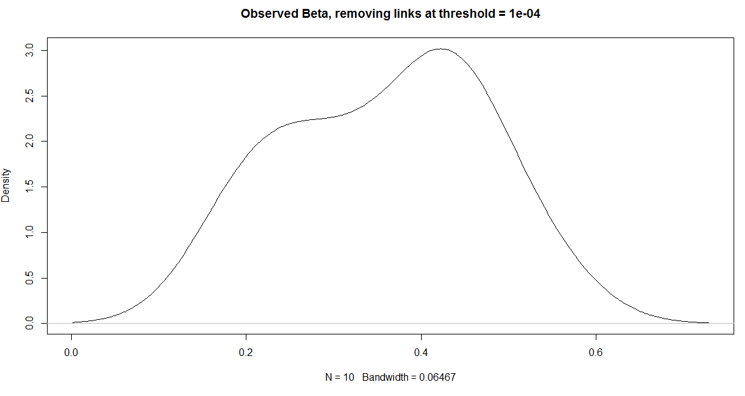

Slide 31
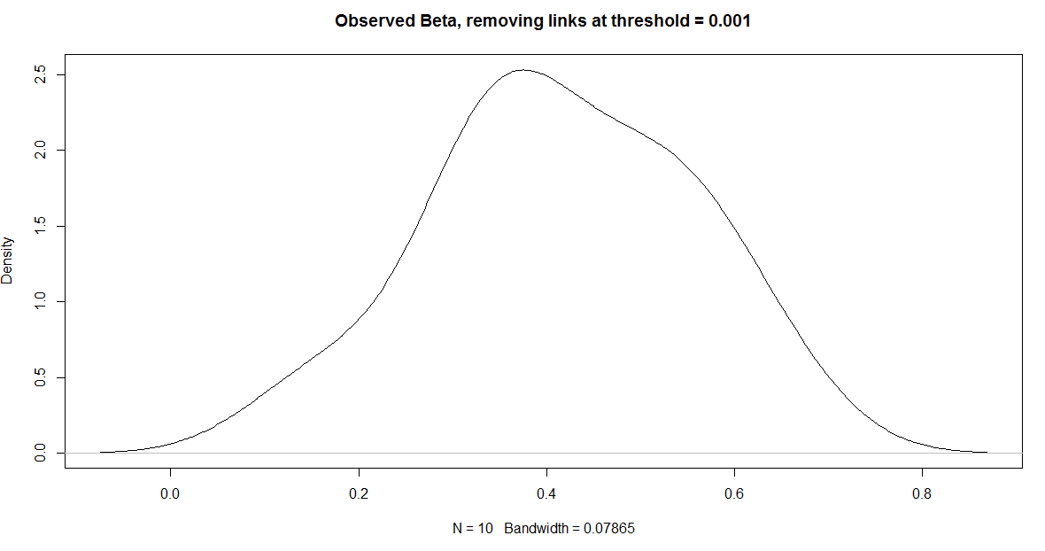

Slide 32
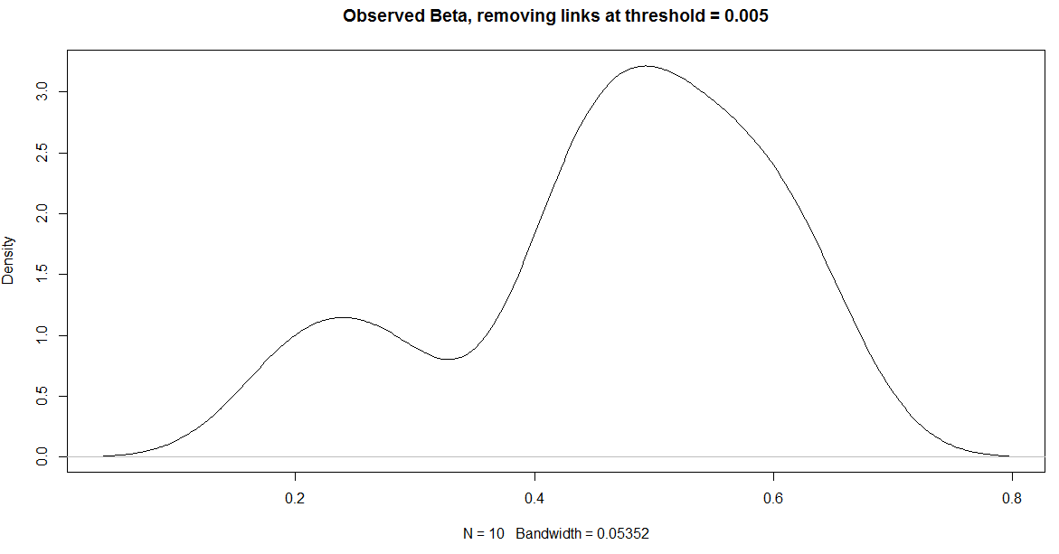

Slide 33
